Slide 1

SQL, t-tests, p-values…Oh My
Northwind Database
LaShanni Butler
Flatiron School
3/22/19

Slide 2

Agenda
Overview
Background
Questions
Recommendations

Slide 3
Overview
What is Structured Query Language (SQL)?
SQL stands for Structured Query Language
SQL lets you access and manipulate databases
The uses of SQL include modifying database table and index structures; adding, updating and deleting rows of data; and retrieving subsets of information from within a database, queries and more
Sources:
https://www.w3schools.com/sql/sql_intro.asp
https://searchsqlserver.techtarget.com/definition/SQL

Slide 4

Background
The Ask?
We’re looking at the Northwind database (which is fictional) created by Microsoft
Based on this, we’re generating a series of hypothesis test to get analytic insights into the company
What is Hypothesis Testing?
Hypothesis testing is a process to test claims about the population on the basis of sample.
Sources:
http://www.geeksengine.com/article/northwind.html
https://www.quora.com/How-do-you-explain-hypothesis-testing-to-a-layman

Slide 5
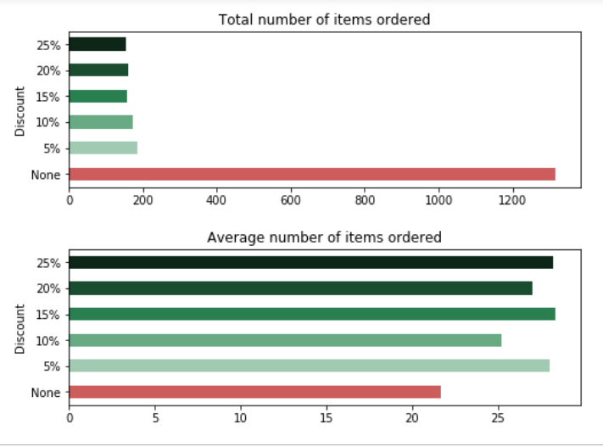
Question #1
Does discount amount have a statistically significant effect on the quantity of a product in an order? If so, at what level(s) of discount?
Yes: the number of products ordered was higher with a discount discount.

Slide 6
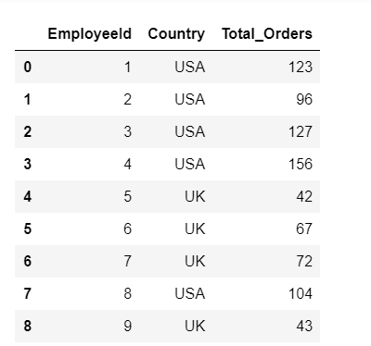
Question #2
Is there a statistically significant difference in USA vs. London employee performance?
Yes: the USA employees outperform the London based employees.

Slide 7
Question #3
Is there a statistical significance between discounts given by USA vs. London employees??
Yes: there is a difference in the discount amounts given by the USA and London employees.

Slide 8
Question #4
Do London employees have higher invoice totals than USA employees?
No: London invoice totals are just about average (or higher) than USA invoice totals

Slide 9
Recommendations
Based on the findings, the following recommendations were made:
Understand how to drive sales without having to entice customers with discounts (frequent discounts hurt the bottom line)
Deeper analysis into why USA is outperforming London offices (could it be due to more customers in the region?)
USA employees offer more discounts than London (hence they are selling more). Both offices should consider using the same criteria for sales. Also explore if there are any factors that prevent London from selling like the USA.

